Slide 1
THE STORY
The Disciples Path series was created by disciple-makers for disciple-makers. We recruited 14 disciple-making church leaders to think through how to instill the doctrines, biblical understandings, principles, and practices of discipleship with the end of making disciples who would make disciples.
The experts did much more than simply define the principles and practices that would be utilized. They determined the studies to create, the sessions to include, and the format to use. And, to ensure consistency and to preserve the passion,
The outcome is a series of studies that, when used as suggested, is a powerful tool in the hands of anyone willing to disciple another believer.

Slide 2
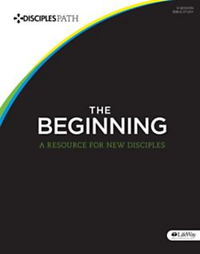
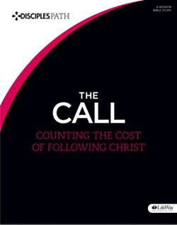
TAKE THE NEXT STEP

Slide 3
THE BEGINNING CONTENTS
A NOTE FOR DISCIPLE MAKERS
WHAT IS A DISCIPLE
HOW TO USE THIS RESOURCE
SESSION 1 WHAT JUST HAPPENED
SESSION 2 THE CENTRALITY OF CHRIST
SESSION 3 TIME WITH JESUS
SESSION 4 THE BLESSING OF COMMUNITY
SESSION 5 JOINING JESUS ON MISSION
LEADER INSTRUCTIONS

Slide 4
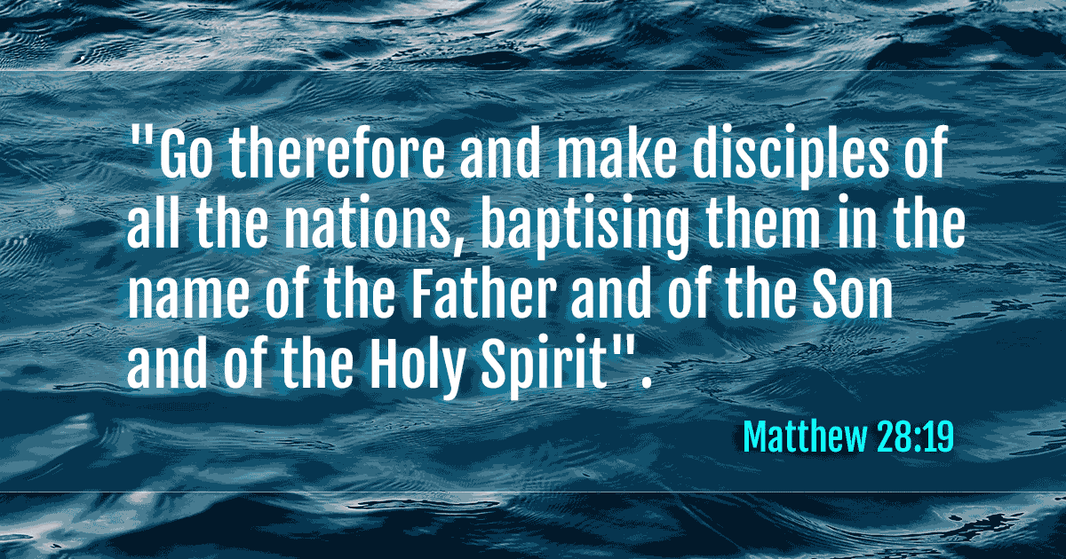
A NOTE FOR DISCIPL MAKERS

Slide 5
MATTHEW 28:19
DISCIPLESHIP IS THE PRIMARY GOAL OF CHRISTIANS
“The disciples path series is a simple tool, no for making disciples but for enabling all of us to take hold of and obey Jesus’ great, enduring commission.”

Slide 6
WHAT IS A DISCIPLE?
ONE WHO HAS CHOSEN TO FOLLOW JESUS
HIS COMMAND TO HIS FIRST RECRUITS WERE FOLLOW ME
LUKE 6:40 The student is not above the teacher, but everyone who is fully trained will be like their teacher.

Slide 7
1 John 3:1 See what great love the Father has lavished on us, that we should be called children of God! And that is what we are! The reason the world does not know us is that it did not know him.
A CHILD OF GOD
1 Peter 2:11 Dear friends, I urge you, as foreigners and exiles, to abstain from sinful desires, which wage war against your soul.
AN ALIEN IN THIS WORLD
2 Cor. 5:17,20 Therefore, if anyone is in Christ, the new creation has come: The old has gone, the new is here! (20) We are therefore Christ’s ambassadors, as though God were making his appeal through us. We implore you on Christ’s behalf: Be reconciled to God.
AN AMBASSADOR FOR CHRIST

Slide 8
YOUR SMALL GROUP
GET STARTED
GROUP DISCUSSION
PRAY TOGETHER AND REFLECT ON LESSON SHARED BY PASTOR
THE STORY (FOLLOW QUESTIONS FOR DISCUSSION)
KNOW THE STORY
UNPACK THE STORY
ENGAGE – GROUP ACTIVITY PROVIDED BY PASTOR

Slide 9
INDIVIDUAL DISCOVERY WEEKLY ACTIVITIES
WORSHIP
PERSONAL STUDY
APPLICATION (READING PLAN)

Slide 10
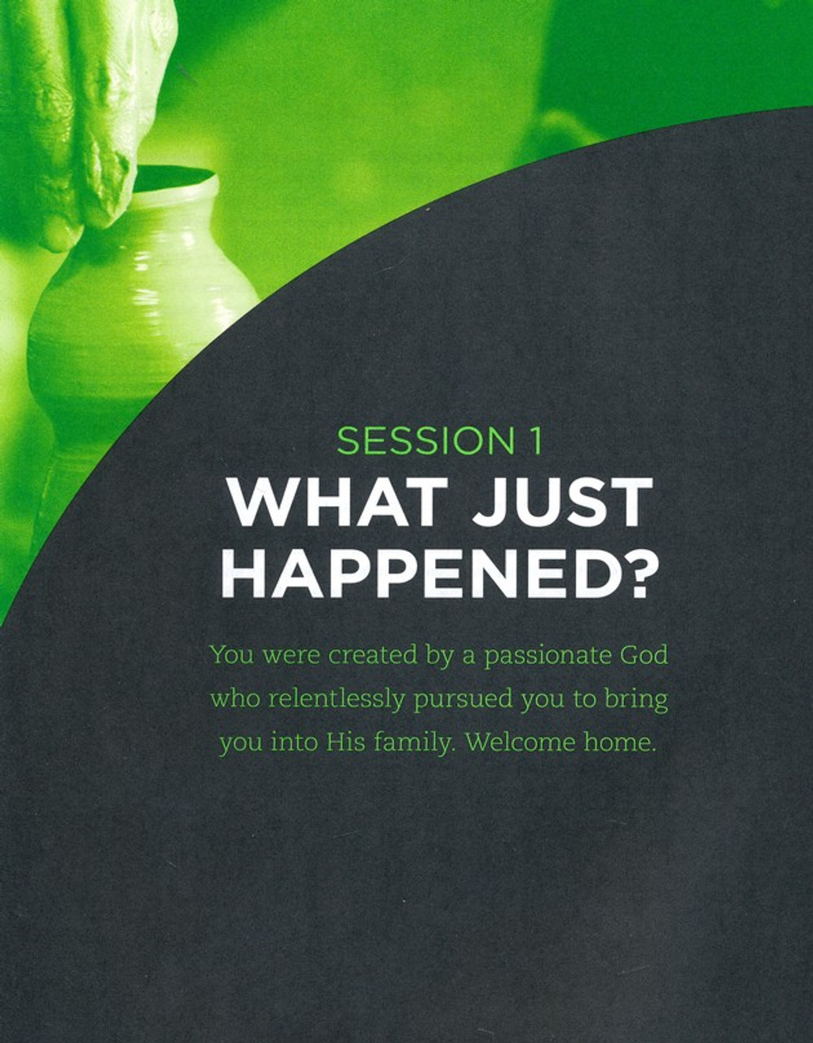
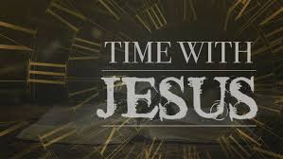
REFLECT:
I have decided to be a Disciple and nothing less for Jesus.
I have decided to have Jesus as the CENTER of my words and my actions.
3. I will continue to COMMIT to the Engagement Exercises and Bible Reading.

Slide 11
Lesson Introduction:
As we pray, let us
Thank God for the privilege of meeting together as part of a community.
Talk to God honestly about our feelings and associations connected with the church, including your past experiences with church and church members.
Ask for wisdom when it comes to finding your place and your voice in His community

Slide 12
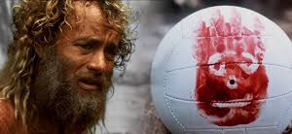
What emotions do you experience when you’re alone for an extended period?
How do you respond to the truth that following Jesus was never intended to be a private relationship?

Slide 13
Knowing the Story
A Promise Jesus made to His disciples after His resurrection.
ACTS 1:8
“But you will receive power when the Holy Spirit has come on you, and you will be My witnesses in Jerusalem, in all Judea and Samaria, and to the ends of the earth.

Slide 14
How did the New Community of Believers Relate to One Another Acts 2: 42-47 NIV
The Fellowship of the Believers
⁴² They devoted themselves to the apostles’ teaching and to fellowship, to the breaking of bread and to prayer. ⁴³ Everyone was filled with awe at the many wonders and signs performed by the apostles. ⁴⁴ All the believers were together and had everything in common. ⁴⁵ They sold property and possessions to give to anyone who had need. ⁴⁶ Every day they continued to meet together in the temple courts. They broke bread in their homes and ate together with glad and sincere hearts, ⁴⁷ praising God and enjoying the favor of all the people. And the Lord added to their number daily those who were being saved.

Slide 15
How did the New Community of Believers Relate to One Another Acts 2: 41-47 MSG
⁴¹⁻⁴² That day about three thousand took him at his word, were baptized and were signed up. They committed themselves to the teaching of the apostles, the life together, the common meal, and the prayers.
⁴³⁻⁴⁵ Everyone around was in awe—all those wonders and signs done through the apostles! And all the believers lived in a wonderful harmony, holding everything in common. They sold whatever they owned and pooled their resources so that each person’s need was met.
⁴⁶⁻⁴⁷ They followed a daily discipline of worship in the Temple followed by meals at home, every meal a celebration, exuberant and joyful, as they praised God. People in general liked what they saw. Every day their number grew as God added those who were saved.

Slide 16
Unpacking the Story
How would you define the word CHURCH?
How would you describe past experiences with church?

Slide 17
Church (def.)
The church is the community of people who follow Jesus Christ as Lord.
WHAT IS THE PURPOSE OF THE CHURCH?

Slide 18
1. To exist as a community of Christ followers who encourage, support and equip one another.
2. To serve as representatives of God’s kingdom to accomplish His work in the world.

Slide 19
What do you look forward to when it comes to participating in the life of the church?
What emotions do you experience when you help others? Why?
When have you received encouragement or support as part of a community?

Slide 20
Have you ever desired or needed help?
In what areas of your life do you currently feel unsure or underprepared?
Prayer Request (Text Me, I want to specifically pray with you and for you)

Slide 21
Bible Reading Mark 10:17 – Mark 13
Pray Daily
Do a self examination during corporate worship
What did I appreciate most and why?
What was confusing or unclear and why?
How would I describe my efforts to connect with God during the worship experience?
How can I improve?

Slide 22
1 Corinthians 12:12-14 New International Version
Unity and Diversity in the Body
¹² Just as a body, though one, has many parts, but all its many parts form one body, so it is with Christ. ¹³ For we were all baptized by one Spirit so as to form one body—whether Jews or Gentiles, slave or free—and we were all given the one Spirit to drink. ¹⁴ Even so the body is not made up of one part but of many.
Write down your initial reaction to this narrative.

Slide 23
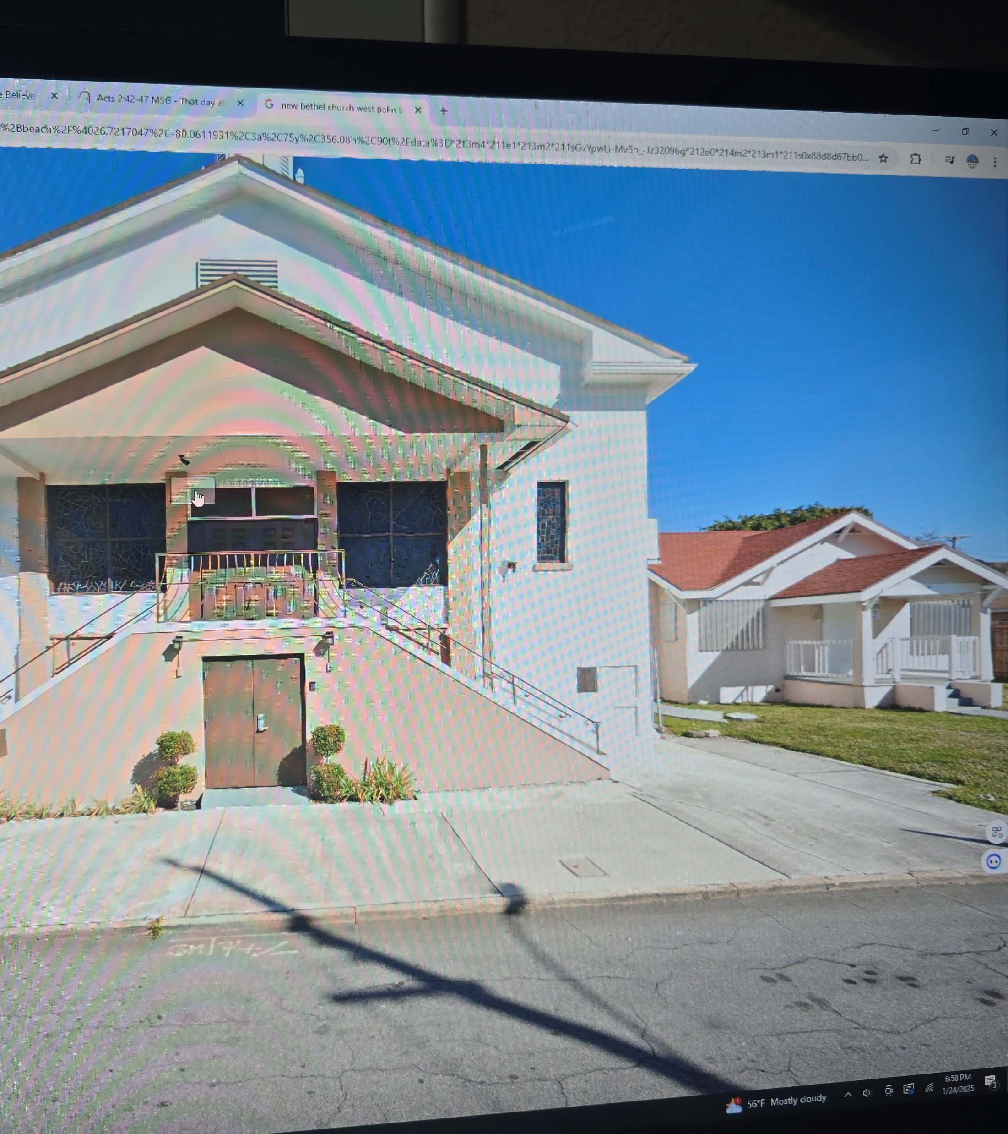
1. How does the verses below help you understand the nature of the Church?
1 Cor. 12:17-18 “If the whole body were an eye, where would the hearing be? If the whole body were an ear, where would the sense of smell be? But now God has placed each one of the parts in one body just as He wanted.
How do these verses help you understand your place in t he church?

Slide 24
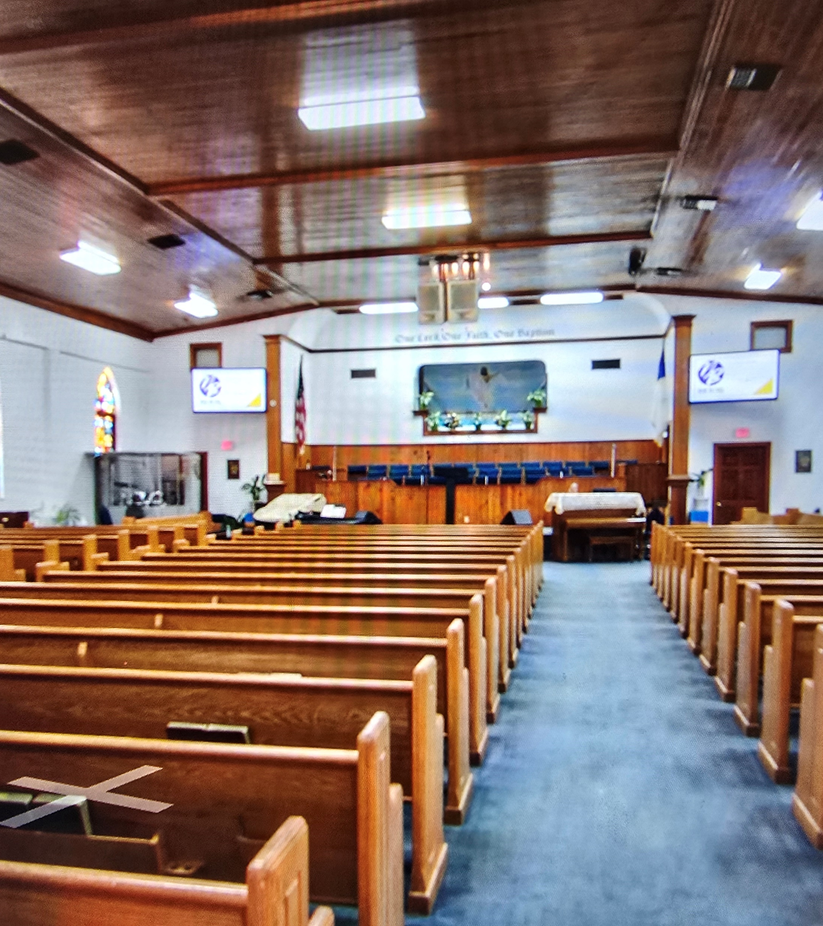
1 Peter 2:9-10 But you are a chosen people, a royal priesthood, a holy nation, God's special possession, that you may declare the praises of him who called you out of darkness into his wonderful light. 10 Once you were not a people, but now you are the people of God; once you had not received mercy, but now you have received mercy.

Slide 25
Two Practices of the Church Community
Romans 6:3-4 Or don’t you know that all of us who were baptized into Christ Jesus were baptized into his death? ⁴ We were therefore buried with him through baptism into death in order that, just as Christ was raised from the dead through the glory of the Father, we too may live a new life.
Matthew 28:18-20
Acts 2:37-41
Acts 8:26-40

Slide 26
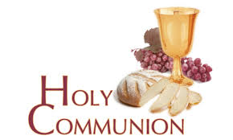
The Second Practice of the Church Community
Luke 22:10-20 ¹⁹ And he took bread, gave thanks and broke it, and gave it to them, saying, “This is my body given for you; do this in remembrance of me.”
²⁰ In the same way, after the supper he took the cup, saying, “This cup is the new covenant in my blood, which is poured out for you.

