Slide 1
THE STORY
The Disciples Path series was created by disciple-makers for disciple-makers. We recruited 14 disciple-making church leaders to think through how to instill the doctrines, biblical understandings, principles, and practices of discipleship with the end of making disciples who would make disciples.
The experts did much more than simply define the principles and practices that would be utilized. They determined the studies to create, the sessions to include, and the format to use. And, to ensure consistency and to preserve the passion,
The outcome is a series of studies that, when used as suggested, is a powerful tool in the hands of anyone willing to disciple another believer.

Slide 2
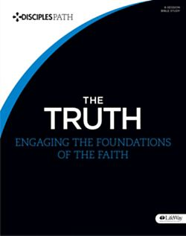
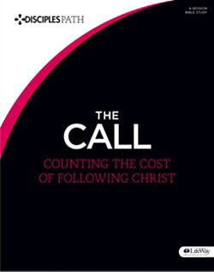
TAKE THE NEXT STEP

Slide 3
THE BEGINNING CONTENTS
A NOTE FOR DISCIPLE MAKERS
WHAT IS A DISCIPLE
HOW TO USE THIS RESOURCE
SESSION 1 WHAT JUST HAPPENED
SESSION 2 THE CENTRALITY OF CHRIST
SESSION 3 TIME WITH JESUS
SESSION 4 THE BLESSING OF COMMUNITY
SESSION 5 JOINING JESUS ON MISSION
LEADER INSTRUCTIONS

Slide 4
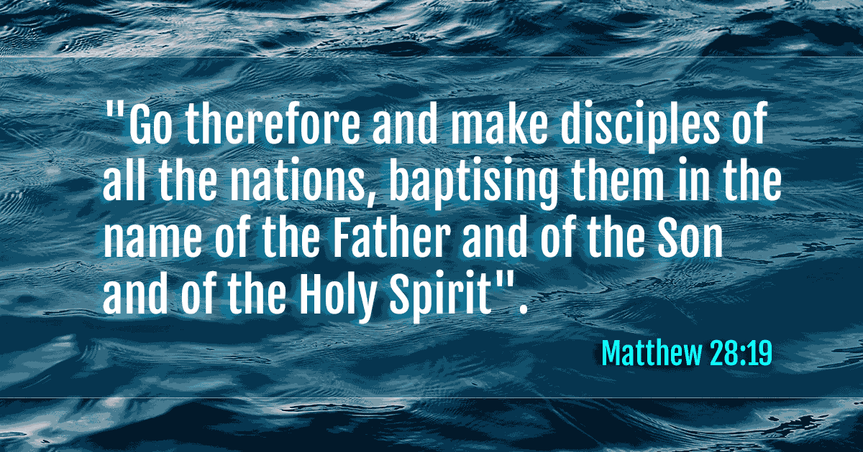
A NOTE FOR DISCIPL MAKERS

Slide 5
MATTHEW 28:19
DISCIPLESHIP IS THE PRIMARY GOAL OF CHRISTIANS
“The disciples path series is a simple tool, no for making disciples but for enabling all of us to take hold of and obey Jesus’ great, enduring commission.”

Slide 6
WHAT IS A DISCIPLE?
ONE WHO HAS CHOSEN TO FOLLOW JESUS
HIS COMMAND TO HIS FIRST RECRUITS WERE FOLLOW ME
LUKE 6:40 The student is not above the teacher, but everyone who is fully trained will be like their teacher.

Slide 7
WHAT IS A DISCIPLE OF JESUS?
A CHILD OF GOD (JOHN 1:31)
AN ALIEN IN THIS WORLD (1 PETER 2:11)
AN AMBASSADOR FOR CHRIST (2 COR. 5:17,20)

Slide 8
YOUR SMALL GROUP
GROUP DISCUSSION
GET STARTED – PRAY TOGETHER AND REFLECT ON LESSON SHARED BY PASTOR
THE STORY (FOLLOW QUESTIONS FOR DISCUSSION)
KNOW THE STORY
UNPACK THE STORY
ENGAGE – GROUP ACTIVITY PROVIDED BY PASTOR

Slide 9
INDIVIDUAL DISCOVERY /WEEKLY ACTIVITIES
WORSHIP
PERSONAL STUDY
APPLICATION (READING PLAN)

Slide 10
The Disciples Path The Beginning 1. What Just Happened

Slide 11
THE STORY (LUKE 5:4-11)
SMALL GROUP DISCUSSION QUESTIONS
WHAT ARE SOME PRACTICAL EXAMPLES OF WHAT FOLLOWING JESUS LOOKS LIKE IN YOUR LIFE?
WHAT OBSTACLES WOULD YOU OR ARE YOU HAVING TO DEAL WITH TO FOLLOW JESUS? IN WHAT WAYS IS IT EASY TO FOLLOW JESUS?

Slide 12
The Story
https://www.bible.com/videos/25127-luke-5-1-16

Slide 13
Unpacking of the Story Creation. Fall. Redemption. Re-creation. These four events represent the great story of God – the gospel story. It was the story that Simon peter was swept into and it’s the story you have now been swept into. Our lives make sense only as we understand them against this backdrop.
Creation – In the beginning, God created. At the sound of His voice, galaxies were hurled into orbit and the smallest organisms were established. Water was pure, creation was untainted, and life was perfect.. Then God created mand and woman. Fashioned with His own hands and infused with His own breath, he created Adam and Even to be in relationship with Him and to be stewards of His creation.
Fall – Then, the Villain entered the story. Twisting the words of God and promising a better life, Satan planted a seed of unbelief in the woman’s heart.. Eve doubted the goodness and trustworthiness of God and reached for the very thing that compromised her relationship with Him. Adam and Eve believed a lie, turned against God, and pursued a story of their own making which left them separated from their Creator. Sin entered the world through humanity, and everything broke.. And that’s what sin is: turning away from God’s desire with actions, attitudes, or thoughts.

Slide 14
UNPACKING THE STORY CREATION THE FALL OF MANY
SMALL GROUP DISCUSSION QUESTION(S)
WHY DO YOU THINK IT’S IMPORTANT TO KNOW GOD AS CREATOR?
WHAT HAVE YOU BEEN TAUGHT ABOUT THE NATURE AND CONSEQUENCES OF SIN?
HOW DO YOU SEE SIN’S EFFECTS TODAY?

Slide 15
Unpacking of the Story Redemption. Re-Creation.
Redemption - In order to reverse the disastrous effects of sin, to free people from the clutches of the Villain, and to restore people to /God the Father, Jesus came to the earth with His eyes on the cross. Full God, Jesus made the perfect sacrifice to pay the debt o four sin and to cancel the curse of death on our lives.. Fully human, Jesus was able to completely represent mand before God. Redemption had come.. On the third day, Jesus rose from the grave to conquere sin and death once and for all.
Re-Creation – The story didn't end at the empty tomb; it had just begun.. The great story of God would explode across the globe and change the hears and lives of men and women for all eternity. All creation is moving toward a great day when Jesus returns and fixes everything that’s broken once and for all.

Slide 16
UNPACKING THE STORY REDEMPTION RECREATION
SMALL GROUP DISCUSSION QUESTION(S)
WHAT IS SIGNIFICANT TO YOU ABOUT JESUS BEING BOTH FULLY GOD AND FULLY MAN?
WHEN YOU LEARN MOR ABOUT GOD IS THERE ANYTHING THAT SURPRISES YOU? WHY?

Slide 17
THE ENGAGING EXCERCISE
READ PHILIPPIANS 2:5-11 (READ THIS PASSAGE OUT LOUD AND MAKE A LIST OF THE ATTRIBUTES AND ACTIONS OF JESUS THAT YOU BELIEVE HIS FOLLOWERS SHOULD IMITATE.

Slide 18
INDIVIDUAL DISCOVERY /WEEKLY ACTIVITIES
WORSHIP
BIBLE READING (MARK 1 -4)
DO THE DEVOTIONAL –GIVEN BY PASTOR
PRAY DAILY (GREET GOD/TELL HIM WHY YOU ARE THANKFUL/TELL HIM YOUR CONCERNS/ASK HIM TO HELP YOU UNDERSTAND YOUR BIBLE READING/ AND THEN LISTEN BY WAY OF MEDITATING TO HIM.

Slide 19
Weekly Devotional HOMECOMING – The first words preached by Jesus are found in Matthew 4:17, where He said; “Repent, because the kingdom of heaven has come near!” It’s also the foundation for the first sermon preached in the book of Acts, when Peter declared: “Repent … and be baptized, each of you, in the name of Jesus Christ for the forgiveness of your sins, and you will receive the gift of the Holy Spirit” (Acts 2:38). When we hear “repent,” we often think it includes punishment or correction. But this word gives life. It doesn’t mean “get your act together” or clean up your behavior” so much as it means to simply turn around: to turn from sin and turn to god. It implies readiness. It results in a complete change of mind, hear, and action, but the first step is to turn and see God.
REPENTANCE ISNT SOMETHING WE DO IN ORDER TO COME TO GOD, ITS SIMPLY OUR COMING TO GOD. WHAT IS YOUR REACTION TO THIS STATEMENT?
TAKE A MOMEN AND READ LUKE 15:11-24. WHAT AR EYOUR INITIAL THOUGHT FORM OTHE PARABLE OF THE LOST SON?
This story follows the journey of a many who strays far from home and far from the man he was destined to be. But eventually he backs away from his depraved life, turns around, and walks back home.. That’s what repentance is. It’s HOMECOMING. And when we return home, we don’t find a father who is angry or eager to say, “I told you so.” Rather , we see a Father who runs to us. Jesus doesn’t call us to repentance to just change our behavior. He calls us to change our hearts and where we rest our heads. It’s about who or what we are trusting in.
BEFORE TRUSTING IN THE WORK DONE BY CHRIST ON THE CROSS, WHAT WERE THE THINGS YOU TRUSTED IN?
The journey home begins with repentance at the cross. The greatest plot twist in history was God Himself coming to earth to deal with sin. At the cross Jesus took all our sin onto Himself and paid our debt. This paved the way for us to go back home.. Because of this we know we were created by a passionate Father in heaven who relentlessly pursues His children to bring them back to the family. Welcome home.
GIVE AN EXAMPLE OF AN AREA IN YOUR LIFE IN WHICH YOU NEED TO CHANGE DIRECTION.

Slide 20
INDIVIDUAL DISCOVERY /WEEKLY ACTIVITIES
PERSONAL STUDY – (we will cover on Sunday’s)
Read the “How Jesus Came lesson” and “Why Jesus Came”
APPLICATION
Attend church
Connect with others
Memorize 2 Corinthians 5:17
Spend time JOURNALING

Slide 21
Personal Study: HOW JESUS CAME
Isaiah 9:6 “For unto us a child is born, a son will be given, and the government will be on His shoulders. He will be named Wonderful Counselor, Mighty God, Eternal Father, Prince of Peace.
THIS IS GOD’S PROMISE FROM THE BEGINNING OF TIME. He promised that He will make things right with God and man. This is what the coming of Jesus is all about. Jesus has come to not only teach moral lessons or set good examples. He came to liberate, make things right, and start a revolution.
Four Ways in Which He Came:
He left his rightful place in heaven and came in the chaos of humanity. Hebrews 2:9 (He came in a stone feeding trough for animals, the voice of God was heard in the cry of an infant. He came dressed in the skin of His own creation, subjected Himself to the care of His own creation, and fixed His eyes on the salvation of humanity. He turned water into wine. He showed mercy to sexually promiscuous women. He healed the sick. He commanded dead men to walk out of their graves. He loved and showed honor to the scum of society. {Have you ever thought of Jesus in these terms? How does the way Christ to Earth encourage you as we lin a culture tainted by sin?}
He came as a man. (Matt. 1:18, Joh 4:6, John 19:28) Because he was fully human, He’s able to represent us, to pay our penalty, to mediate for us before God, to serve as our example, and to identify with us. PHILIPPIANS 2:7-8 says “He emptied himself by assumg the form of a slave, taking on the likeness of men. Nd when He had come as a man in Hies external form. He humbled Himself by becoming obedient to the point of death – even to death on the cross.”
He came as God. His birth was supernatural. By His own claim, He was and is God. God declared him to be God, and even the demons recognize Him to be God.. He displayed attributes of deity such as working miracles and forgiving sins. (Matt. 1:18, Col 2:9) Because He was fully God, He was able to offer a perfect sacrifice. 1 John 5:20 says “And we know that the Son of God has come and has given us understanding so that we may know the true One. We are in the true One- that is, in His Son Jesus Christ. He is the true God and eternal life.” {Is it difficult for you to grasp the thought of Jesus as fully God and fully man? Why or why not?} {Why is it important that He is both?}
He came to serve, sacrifice, and save. Romans 5:8 declares, “But God proves His own love for us in that while we were still sinners, Christ died for us!” He is uniquely designed to represent people to God and God to people. Because He is fully human, He can offer the sacrifice on our behalf. Because He is fully God, He can offer the perfect sacrifice. 1 John 4:9-10 says “God’s love was revealed among us in this way: God sent His One and Only Son into the world so that we might live through Him. Love consists in this: not that we loved God, but that He oved us and sent His Son to be the propitiation four our sins.”{What’s your reaction to the idea that salvation isn’t found in what we do for God but in what He has done for us?}

Slide 22
Personal Study: Why Jesus Came
Being a Christian is about what you can do for God; it’s about what God has already done for you. Jesus paid our deby, freed us from sin and death, and reconciled us to god and others. Jesus divinely disrupted and reversed the story of humanity. On the cross, our guilt, the bondage of sin, and our separation from God were reconciled.
Guilt: Because of what happened with Adam, the first man, we were all born guilty in our relationship with God. But Jesus paid our debt; one that He Himself did not owe, but because we couldn’t pay it. He paid it. The charges/guilt/debt of sin has been paid by Him. This is CALLED PROPITIATION.
2 Corinthians 5:21 says “He mad the One who did not know sin to be sin for s, so that we might become the righteousness of God in Him.
WRITE DOWN IN YOUR JOURNAL YOUR THOUGHTS ON THE CONCEPT OF GUILT.
Bondage: Jesus defeated the power of sin and death on the cross, liberating us from its grip on our lives and granting us eternal life in Him. Through Jesus, we are freed from sin. This is called REDEMPTION. Romans 6:22-23 says “But now, since you have been liberated from sin and have become enslaved to god, you have your fruit, which results in sanctification- and the end is eternal life! For the wages of sin is death, but the gift of God is eternal life in Christ Jesus our Lord.
WRITE DOWN IN YOUR JOURNAL YOUR THOUGHTS ON THE CONCEPT OF BONDAGE.
Separation: Jesus removed the wedge between us and God and made a way four us to have a relationship with Him. Through Christ, we are reunited with God. This is Called RECONCIATION. Romans 5:10-11 says “For if, while we were enemies, we were reconciled to god through the death of His Son, then how much more, having been reconciled, will we be saved by His life! And not only that, but we also rejoice in ?god through our Lord Jesus Christ. We have now received this reconciliation through Him.
WRITE DOWN IN YOUR JOURNAL YOUR THOUGHTS ON THE CONCEPT OF SEPARATION.
Jesus did not die on the cross to give us comfort and safety. Some people sell salvation like it’s an insurance plan or a safety net. Unfortunately, we sometimes think that coming to God means that everything will be OK. Life will get better. Sometimes, it gets worse. We aren’t promised that everything will be OK; we’re promised His presence. He doesn’t promise to keep us save; rather, He invites us into a dangerous story to be proclaimers of hope in the midst of avery unsafe world.

Slide 24
New Bethel Community Church School
(YOUTH)
Adult Sunday School Lesson
Ministry Courses (Deacons in December)
The Disciples Path –Main Sanctuary
Fresh Church 4th Sundays Sign up Today)
Church Attendance
2nd Sunday November 322 onsite & online
New Bethel Community Church School
Have you visited mynewbethel.org this week?

